Slide 1
REAL SWITCHING OPTIONS I BEST OF TWO OUTPUTS II STOCHASTIC INPUT AND OUTPUT: OPTION TO SHUT DOWN, OPTION TO RESTART III LOWEST COST OF TWO INPUTS

Slide 2
I General Output Switching
EXAMPLES: SHIP COMBINATION CARRIERS=EITHER WET OR DRY CARGO
REAL ESTATE=EITHER RESIDENTIAL OR OFFICE TENANTS
FINANCE CLASSES=EITHER REAL OPTIONS OR
INVESTMENT ANALYSIS ELECTIVES
FINANCE CAREER CHOICE=EITHER ACADEMIA OR CONSULTING OR BUSINESS

Slide 3
SINGLE ONE-WAY SWITCHING

Slide 4
SINGLE OUTPUT SWITCH

Slide 5
VM & SP CONDITIONS

Slide 7
II SUSPENSION & RESTART OPTIONS 19th Century Manchester

Slide 8
General Switching Options
Flexibility has significant value in certain markets, especially for correlation < 1
Trigeorgis and Mason (1987)
Deterministic models unable to capture this option value
Model as an exchange option, but need dimension reducing transformation
Margrabe (1978), McDonald and Siegel (1985), Paxson and Pinto (2005)
Ignore the switching costs
He and Pindyck (1992), Brekke and Schieldrop (2000)
One-factor models
Brennan and Schwartz (1985), Paxson (2005)
Quasi-analytical solution for multi-factor models
Adkins and Paxson (2012)

Slide 9
Two-factor Switching Model
Output price
follows gBm
Input price
follows gBm
Required return on output / input
Convenience yield for output / input
Volatility for output / input
Correlation
Active operating state denoted by 1
Inactive suspended state denoted by 2
Value of asset in state 1
Value of asset in state 2

Slide 10
Two-factor Switching Model
RNVR for state 1:
Solution:
with characteristic root equation:
RNVR for state 2:
Solution:
with characteristic root equation:

Slide 11
Two-factor Switching Model
Economic conditions favour a switch from active to inactive state
when output price is low, and
when input price is high
Economic conditions favour a switch from inactive to active state
when output price is high, and
when input price is low

Slide 12
Two-factor Switching Model
Switching cost from state 1 to state 2
Switching cost from state 2 to state 1
Value matching switching
Optimality conditions

Slide 13
Two-factor Switching Model
Available equations: 2 VM, 4SP, 2Q
Unknowns:
Require:
(i) switching boundary from active to inactive
(ii) switching boundary from inactive to active
To create the boundaries, we set:
then evaluate
Spread between boundaries expressed by the wedges:
and

Slide 14
Two-factor Single Switching Model
Single switch from state 1 to 2 implies abandonment
Value matching switching
Optimality conditions
Q function
Eliminate
to form the boundary relating
and

Slide 15
Two-factor Switching Model – Numerical Illustration

Slide 16
Two-factor Switching Model – Numerical Illustration

Slide 17
Two-factor Switching Model – Numerical Illustration

Slide 18
Two-factor Switching Model – Numerical Illustration

Slide 19
Stakeholders Take Notice

Slide 20
Stakeholders
How much to pay for flexible plant that can be suspended & restarted ?
Effect on employees, as Mary Barton found in Manchester 164 years ago.
Alert CROM monitors input & output prices, updates expected correlations & volatilities.
Adds value by suspending & restarting at appropriate times.

Slide 21
Applications

Slide 22
Further Applications
Alberta tar sands using gas to produce oil…[large Chinese investments there].
Searching for cheaper/more efficient labor, as wages and output prices vary over time.
Airlines shifting capacity, among locations and over time, as seat demand varies.
Financial education shifts among locations and over time, as quality & demand vary.

Slide 23
Further Work Required
Forecasting volatilities and correlations for hardly or rarely traded inputs & outputs.
Data is often within the management accounting system (revenue ASM, and operating cost per ASM for airlines) (RevPAR and CostPAR for hotels).

Slide 24
III Energy INPUT Switching
Substituting natural gas-oil-hydro-coal in electricity generation (flexible facilities, or diversified national energy systems).
Alternative gas-electricity-coal-wood in residential heating.
Switching midnight or early morning grid electricity to running pumped power stations.
Alternative inputs for biodiesel production.

Slide 25
Rape Oil vs. Palm Oil Switching Economics

Slide 26
Two inputs (assets)
Price asset
Risk neutral drift rate
Risk-free rate
Stochastic behaviour for asset
Geometric Brownian Motion (ignore subscript t)
Correlated exogenous shocks
Switching investment cost
Switch from asset 1 to 2
Switch from asset 2 to 1

Slide 27
Value of option to switch input
Using Ito’s lemma, risk neutral fundamental pde:
Solution takes the general form:
Substitute solution

Slide 28
Asset 1 in use
Price of asset 1 when switch to asset 2 is viable
Price of asset 2 when switch to asset 2 is viable
Value of asset 1 in use plus switching option, ignoring output.
Asset 2 in use
Price of asset 1 when switch to asset 1 is viable
Price of asset 2 when switch to asset 1 is viable
Value of asset 1 in use plus switching option, ignoring output.

Slide 29
Value matching condition
Asset 1 in use, switch to asset 2:
Asset 2 in use, switch to asset 1:

Slide 30
VM1:
SP1 – VM1
SP2 – VM1
6 equations
VM2:
SP1 – VM2
SP2 – VM2
2 Q equations
Unknowns: 10

Slide 31
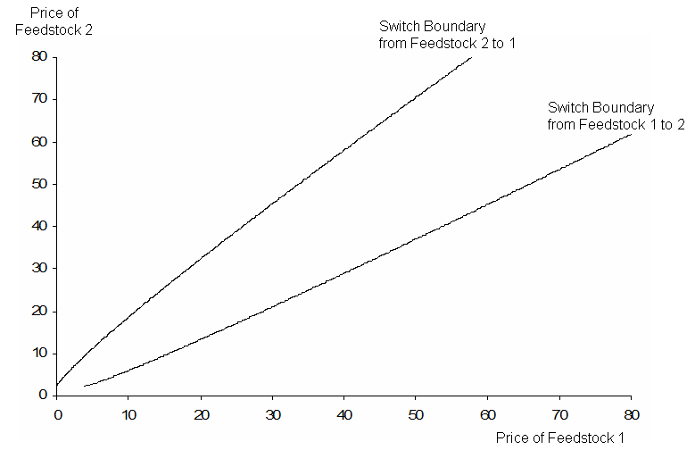
Numerical Illustration ρ=.5

Slide 32
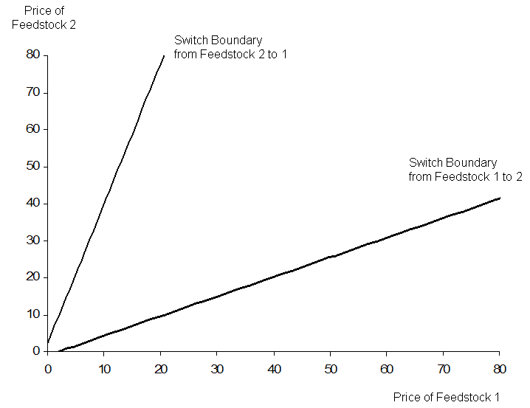
Single Switch Expands Boundaries

Slide 33
CONCLUSION
A quasi-analytical solution for feedstock switching when switch costs are fixed.
Simple solution when only one switch is feasible.
Switch hysteresis increases when correlation is negative or volatility is high, or for a single switch.

Slide 34
Extensions
Plausible empirical application to biodiesel inputs (switching between palm oil & rape) or additions to a refinery so it can switch between WTI and WTS.
Wider extensions to electricity generation.
And to national energy sources, adding perhaps the consideration of sustainability or ecological costs, which are volatile and increase/decrease over time and public awareness.

